Slide 1
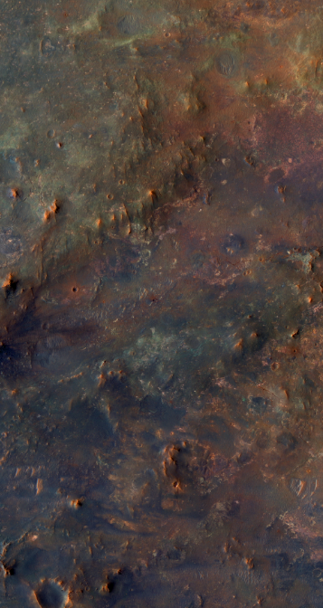

Assessing Synthetic Data Quality and Model Generalization for Planetary Imagery
Clara Salditt, Karan Molaverdikhani, Barbara Ercolano
Workshop on AI-driven Data Engineering and Reusability for Earth and Space Sciences (DARES’25), co-located with the 28th
European Conference on Artificial Intelligence (ECAI 2025), Bologna, Italy, October 25, 2025

Slide 2
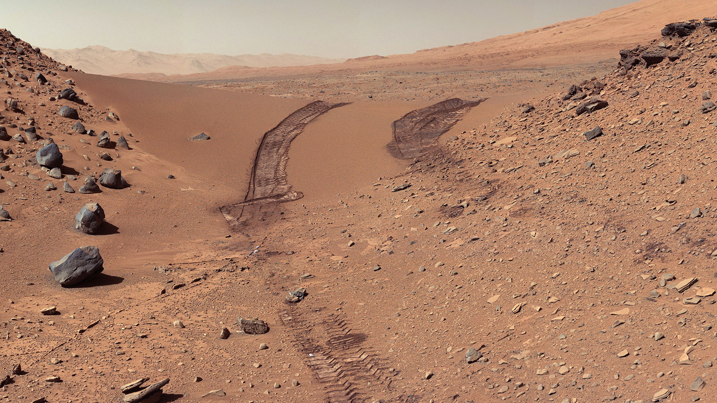

Slide 3
Outline
Motivation: Planets surfaces
Problems: Gaps and bias in real data, finished model training on real data
Solution: Synthetic data?
Conclusion: Data is currency in machine learning -> Data Quality assessment important
Rover landing and navigation

Slide 4

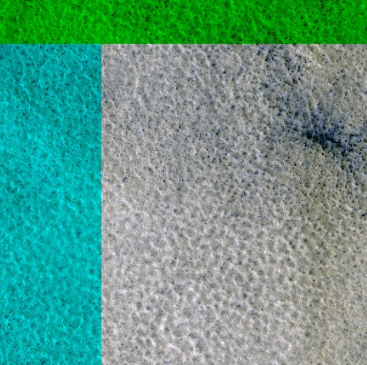
Summary of Methods
Model Training StyleGAN2
Generated Data
Training Data
HiRISE images
Preprocessing
Test Data

Slide 5
Summary of Methods
Model Training StyleGAN2
Training Data
Generated Data
HiRISE images
Preprocessing
ViT/ CNN
Feature embeddings
Test Data

Slide 6

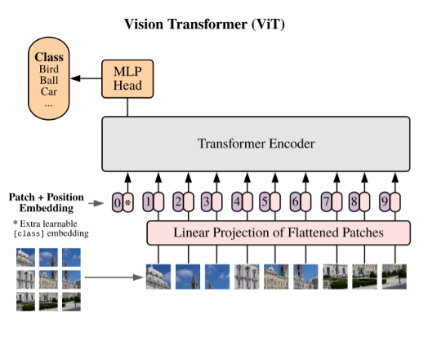
Feature extraction
Inceptionv3 (ImageNet: 1.2 M images 1000 classes)
CLIP (400 M images text pairs, supervised)
DINOv2 (142 M images text pairs, self-supervised, Earth satellite Images)
Notes:
Vit: https://medium.com/one-minute-machine-learning/vision-transformers-one-minute-summary-c1af0aa33c27
CNN: https://www.aiophotoz.com/photos/all-about-convolutional-neural-networks-cnns-by-savindi-wijenayaka.html
Spetifisches version

Slide 7
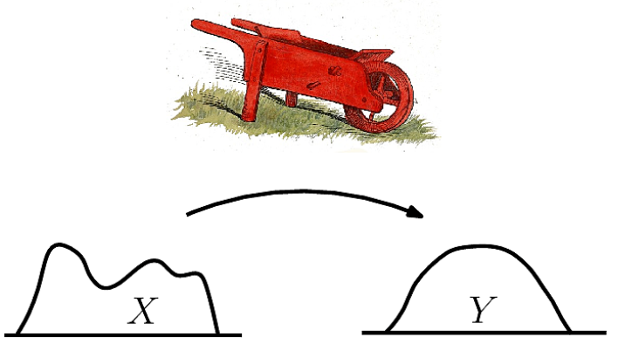

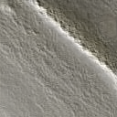
Structure
1. Distribution based metrics
2. Pairwise image similarity metrics
3. Visualization techniques and qualitative feature space analysis

Slide 8
Evaluation metrics
Pairwise image similarity metrics
PSNR (pixel-based)
MS-SSIM (pixel-based)
LPIPS
DREAM-SIM
ISC
FID
KID(poly), KID(rbf)
CMMD
Precision and Recall
PPL
Distribution based metrics
Notes:
Precision and Recall
PPL
UMAP

Slide 9
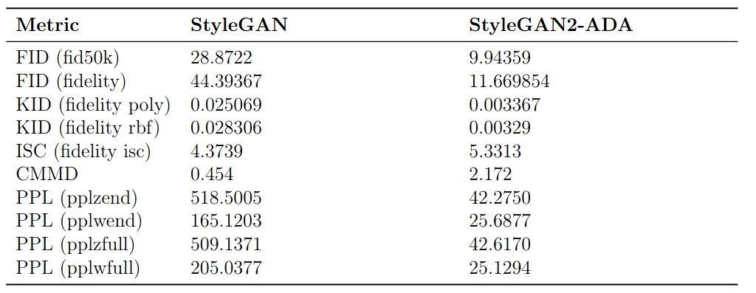
Stylegan2-ada-pytorch

Slide 10
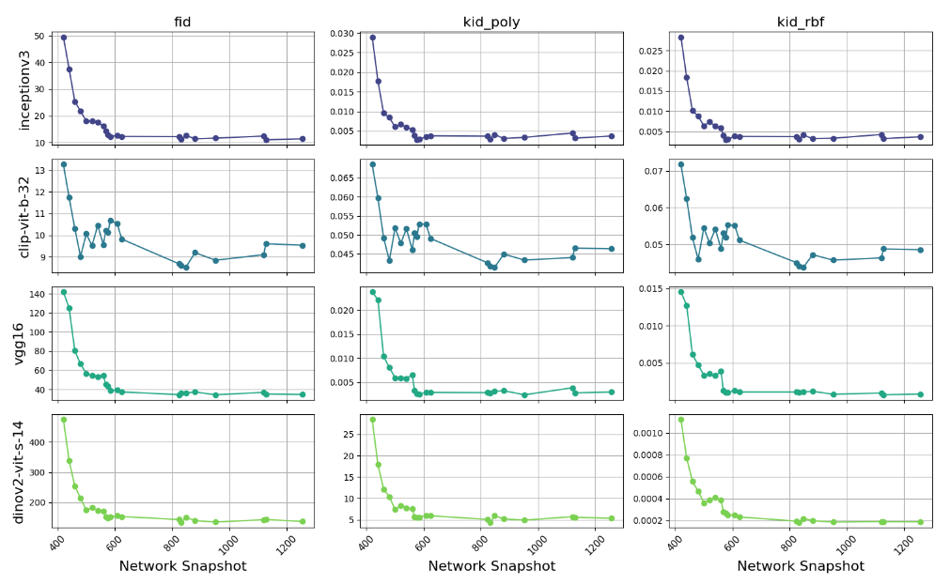

Slide 11
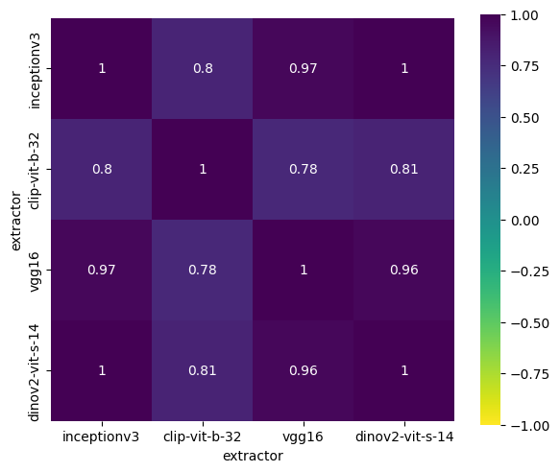
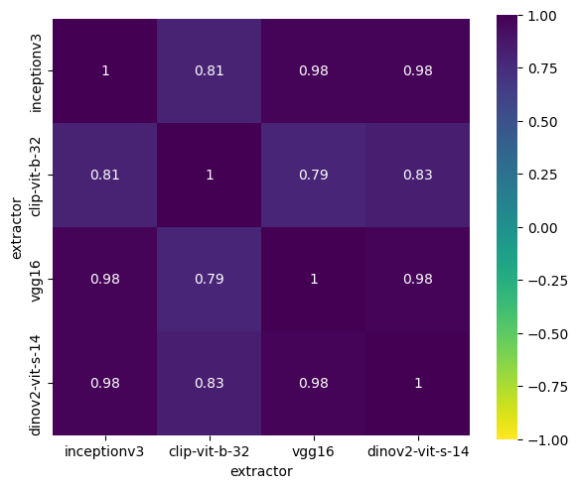

FID
KID poly
KID rbf

Slide 12
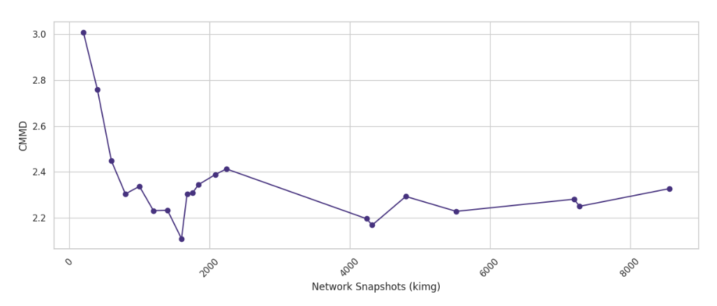

Slide 13
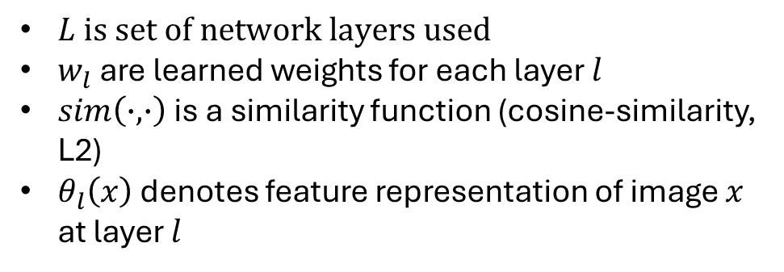
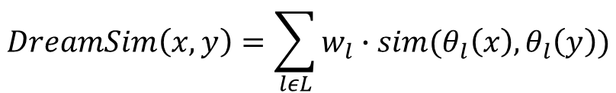
DreamSIM:
$$DreamSim\left(x,y\right)=\sum_{lεL}{w_{l}∙sim(θ_{l}\left(x\right),θ_{l}\left(y\right))}$$
$L is set of network layers used$
$w_{l}$ are learned weights for each layer $l$
$sim\left(∙,∙\right)$is a similarity function (cosine-similarity, L2)
$θ_{l}\left(x\right)$ denotes feature representation of image $x$ at layer $l$

Slide 14
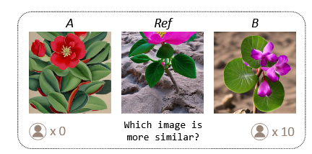
DreamSIM:
$$DreamSim\left(x,y\right)=\sum_{lεL}{w_{l}∙sim(θ_{l}\left(x\right),θ_{l}\left(y\right))}$$
$L is set of network layers used$
$w_{l}$ are learned weights for each layer $l$
$sim\left(∙,∙\right)$is a similarity function (cosine-similarity, L2)
$θ_{l}\left(x\right)$ denotes feature representation of image $x$ at layer $l$
(Fu et al., 2023)

Slide 15
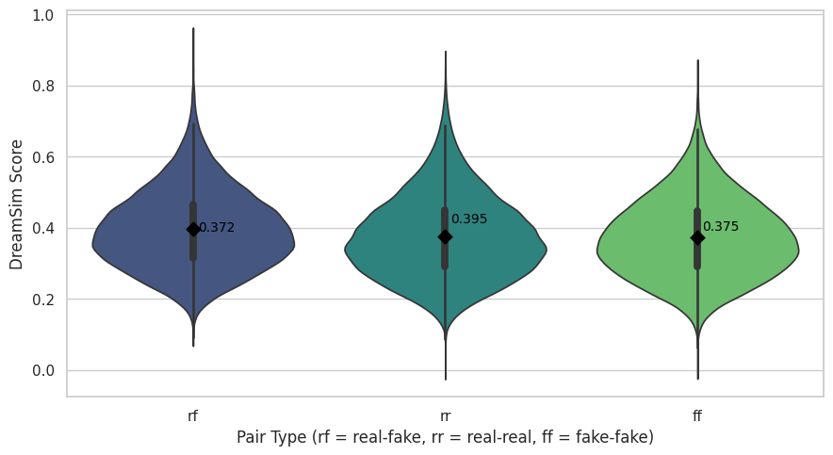
DreamSIM: Random matches

Slide 16
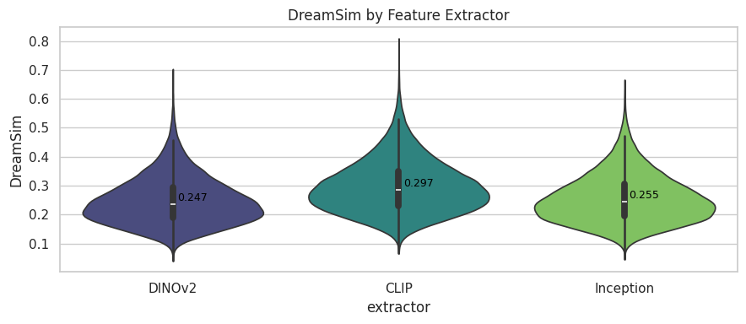

Nearest neighbor paring on Test Data
Nearest neighbor paring on Training Data

Slide 17
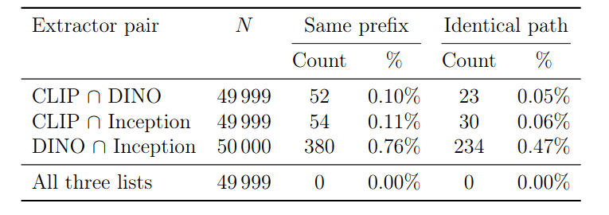
Nearest neighbor paring

Slide 18
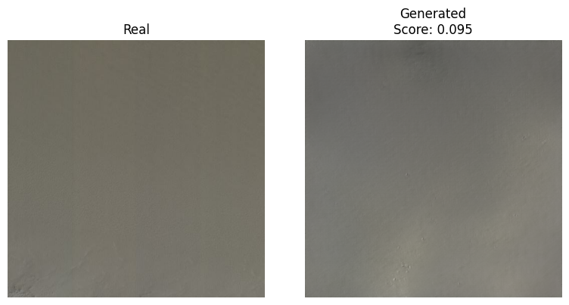
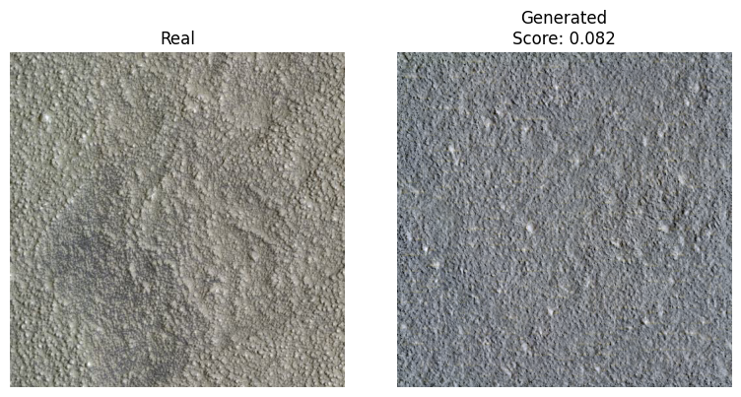
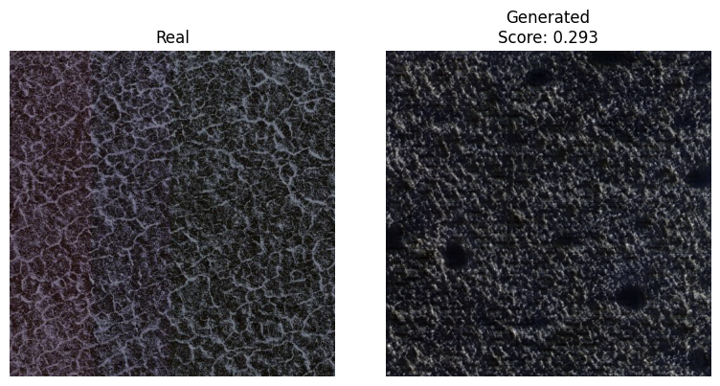
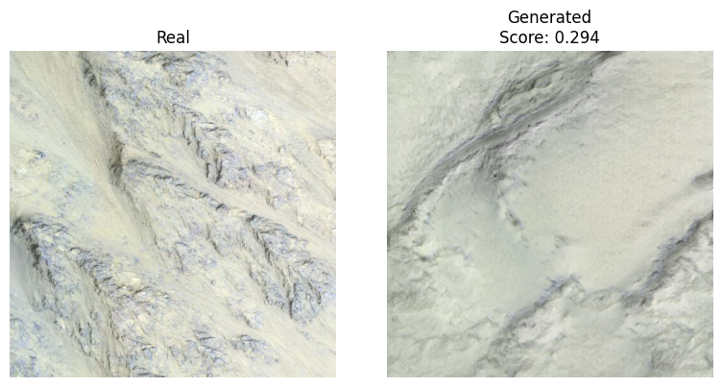
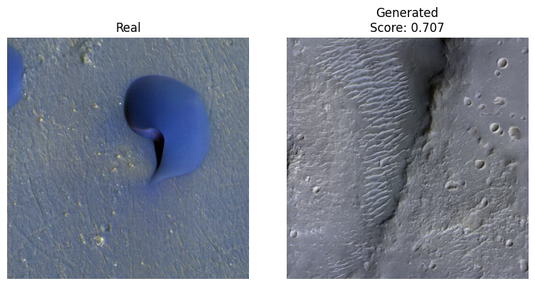
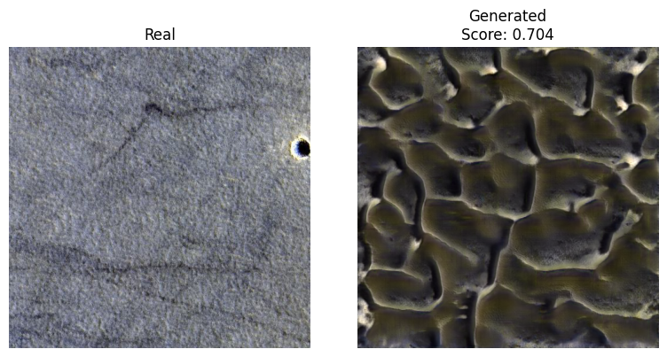
Best scores
Average scores
Worst scores

Slide 19
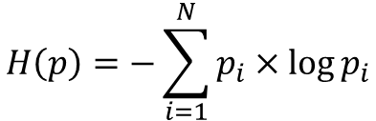
Entropy Bias:
$$H\left(p\right)=−\sum_{i=1}^{N}{p_{i}×\log{p_{i}}}$$
Average over RBG and image pair

Slide 20
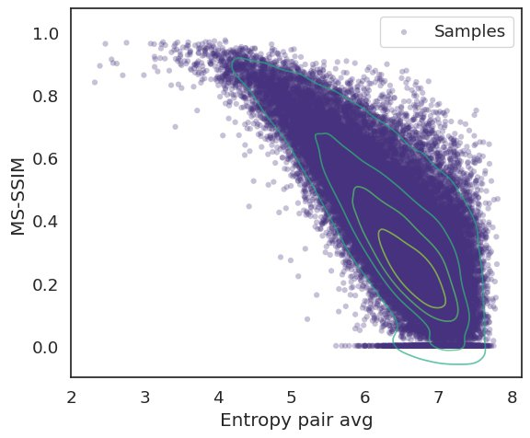
Entropy Bias:
$$H\left(p\right)=−\sum_{i=1}^{N}{p_{i}×\log{p_{i}}}$$
Average over RBG and image pair

Slide 21
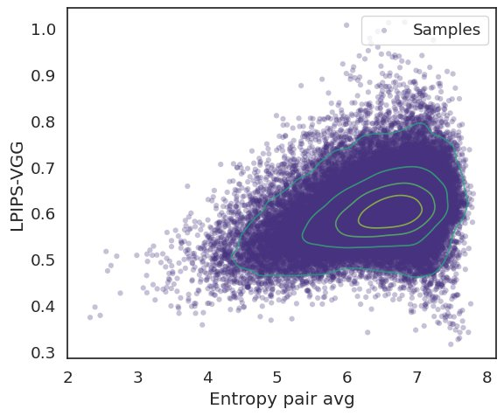
Entropy Bias:
$$H\left(p\right)=−\sum_{i=1}^{N}{p_{i}×\log{p_{i}}}$$
Average over RBG and image pair

Slide 22
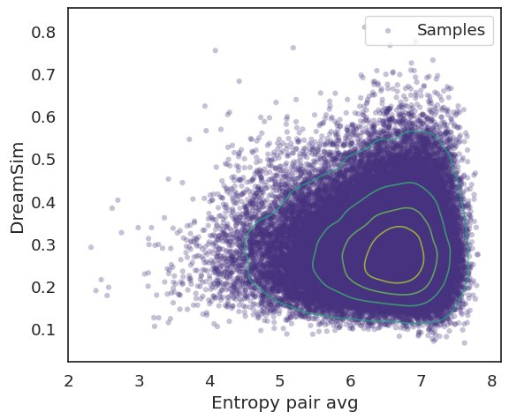
Entropy Bias:
$$H\left(p\right)=−\sum_{i=1}^{N}{p_{i}×\log{p_{i}}}$$
Average over RBG and image pair

Slide 23
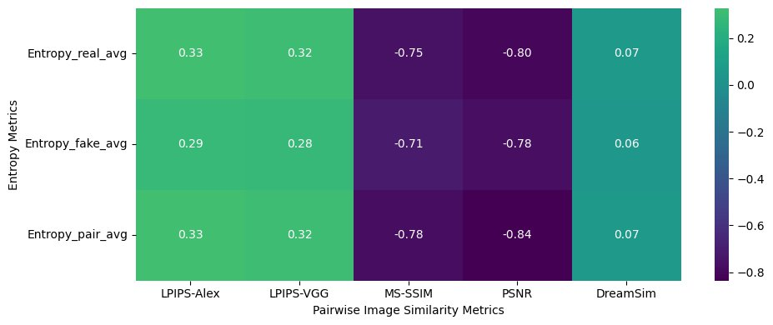
Pearson Correlation between Metrics & Entropy

Slide 24
Conclusion
Fidelity and diversity images compared to benchmarks on popular datasets
Choice of feature extractor: CLIP << Inception < DINO
Pixel-based metrics have entropy biases, reduces for features-based metrics, vanishes when human aligned.
No single reliable metric -> evaluation domain and application specific.

Slide 25
Outlook and open questions
Clip’s “Bump” -> sensitive to color?
Image similarity metrics bias toward simple structure?
Better nearest neighbor matches?

Slide 26
Outlook and open questions
Clip’s “Bump” -> sensitive to color?
Image similarity metrics bias toward simple structure?
Better nearest neighbor matches?
Are models aligned with human perception?

Slide 27
Thank you for listening!

